Slide 1
Instance Generator
Figures and Results

Slide 2
Preliminary Stage

Slide 3
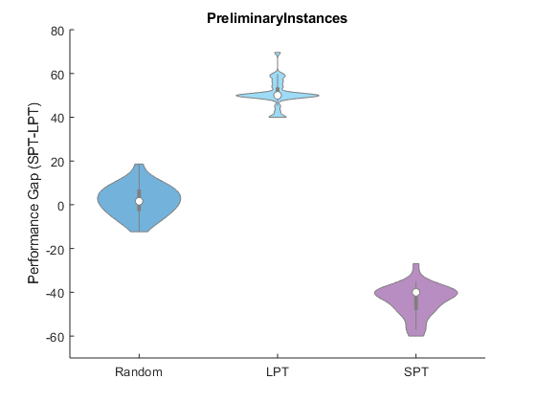

Slide 4
Initial Stage

Slide 5
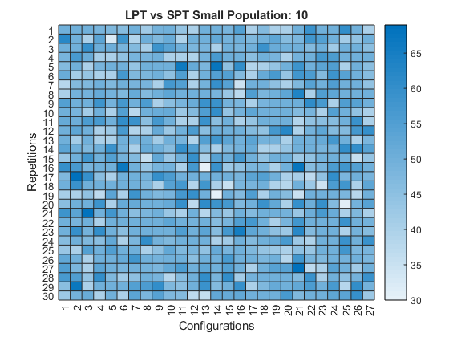

Slide 6
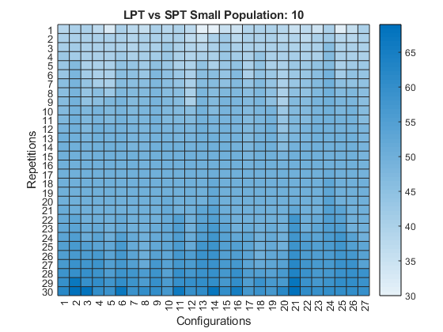

Slide 7
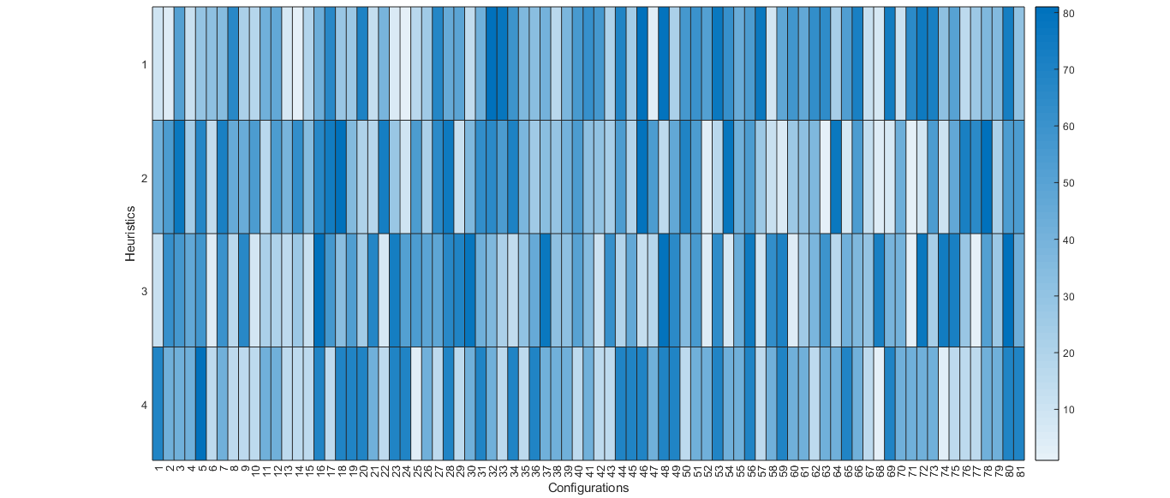
Ranked Median Values

Slide 8
Ranked Median Values Parameters

Slide 9
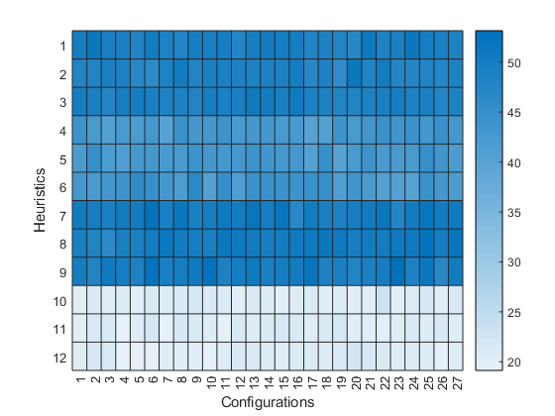
Average Mean Values

Slide 10
Average Mean Values Parameters

Slide 11
Advanced Stage

Slide 12
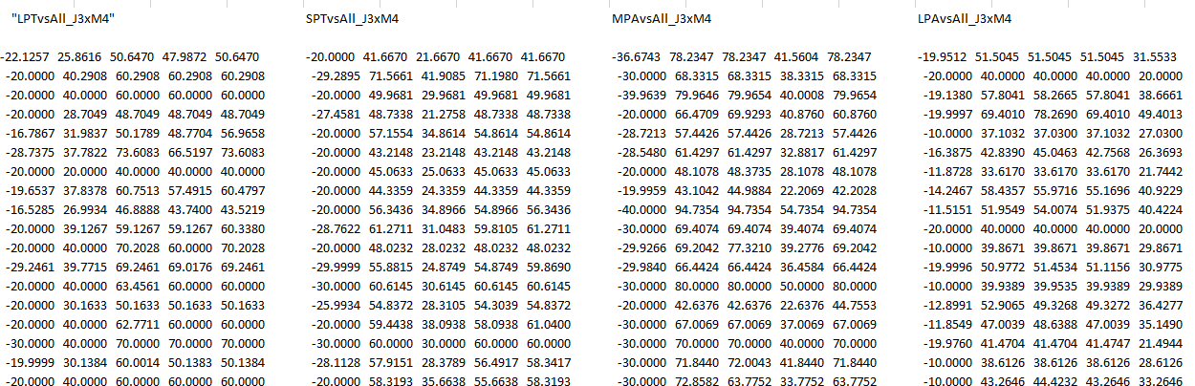
Performance Data

Slide 13
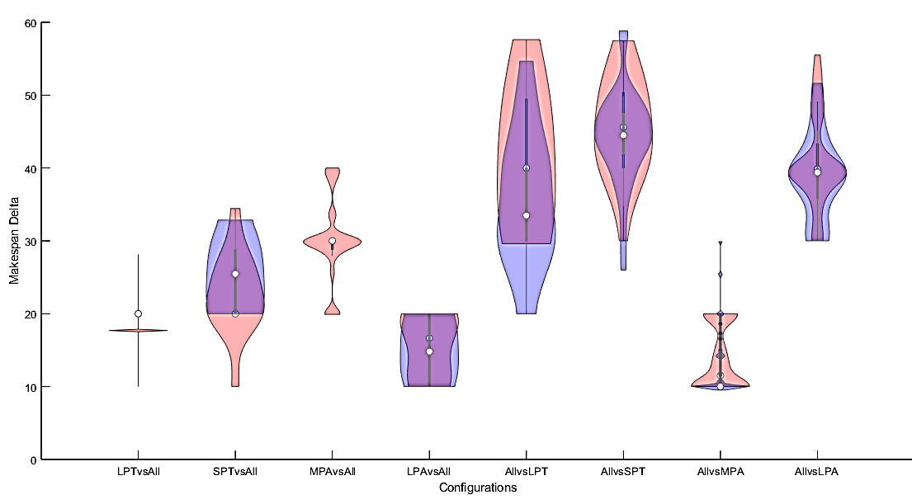
Advanced Instances Violins

Slide 14
Advanced Instances Medians

Slide 15
Parameters Results

Slide 16
Delta Stage

Slide 17
Ranked Median Values Performance Data

Slide 18
Average Mean Values Performance Data

Slide 19
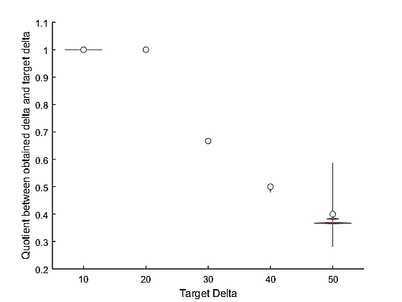
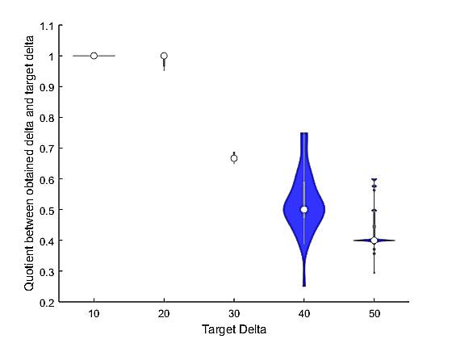
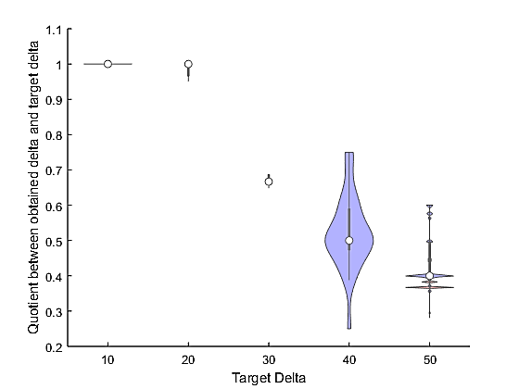
LPTvsAll

Slide 20
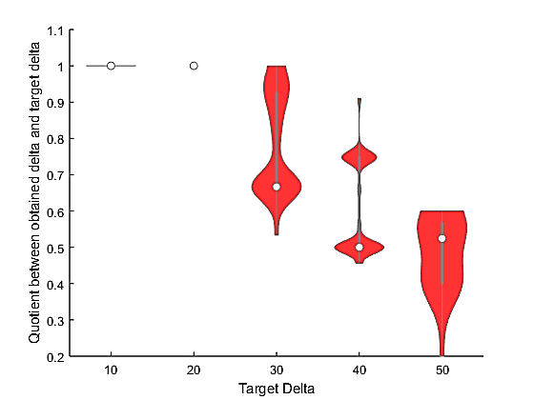
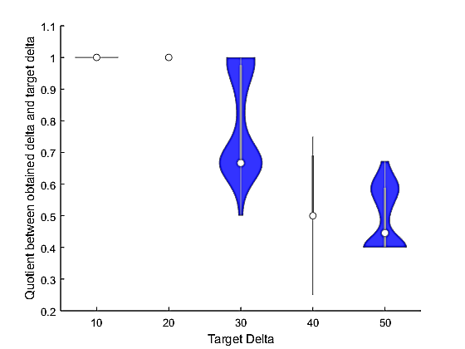
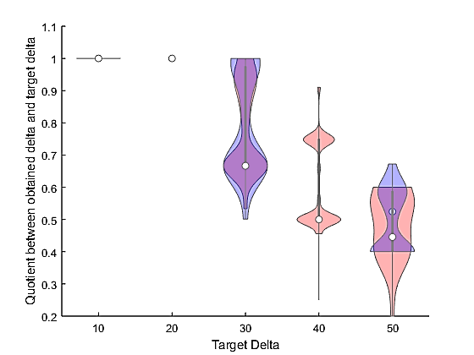
SPTvsAll

Slide 21
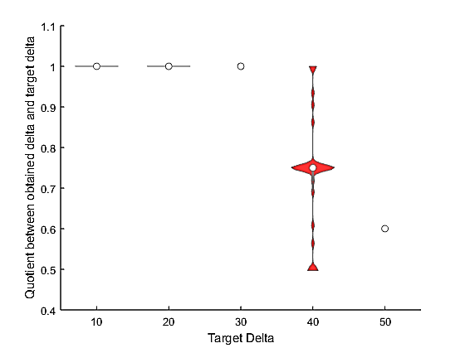
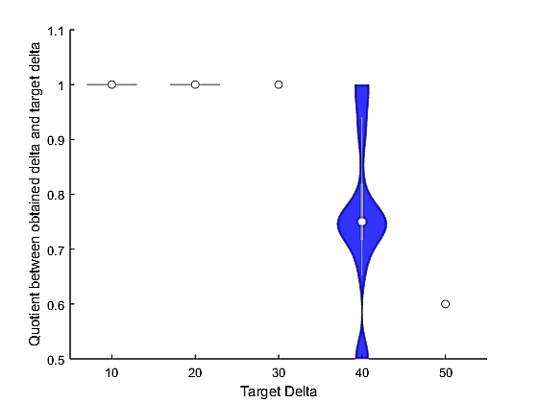
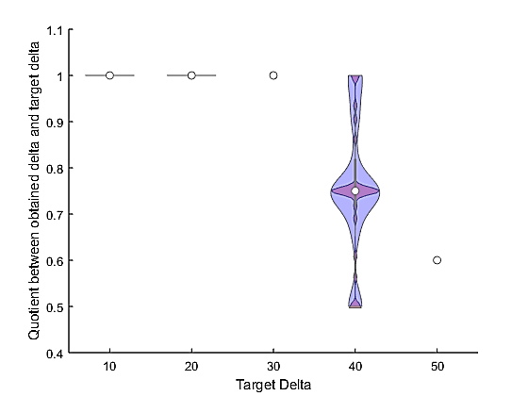
MPAvsAll

Slide 22
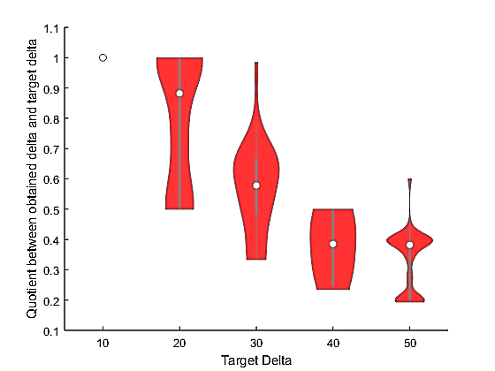
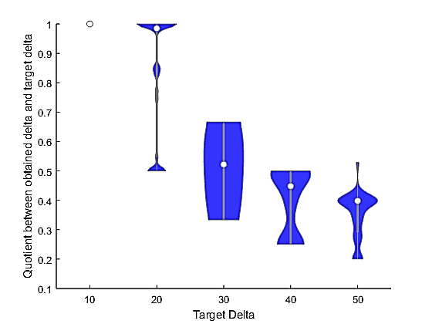
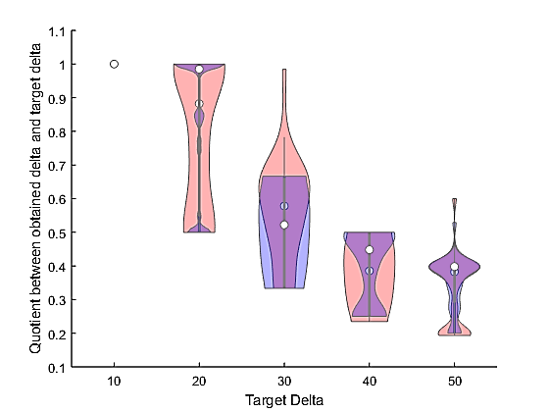
LPAvsAll

Slide 23
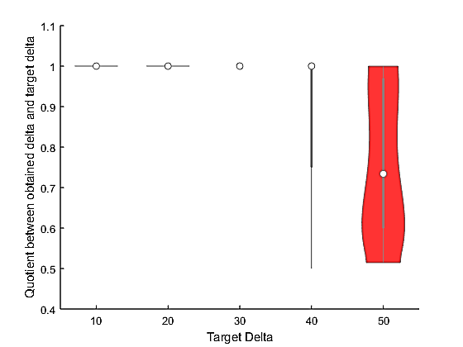
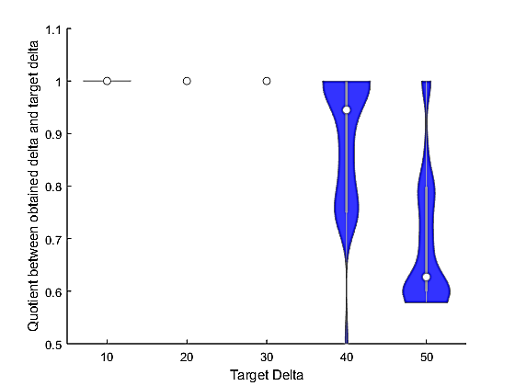
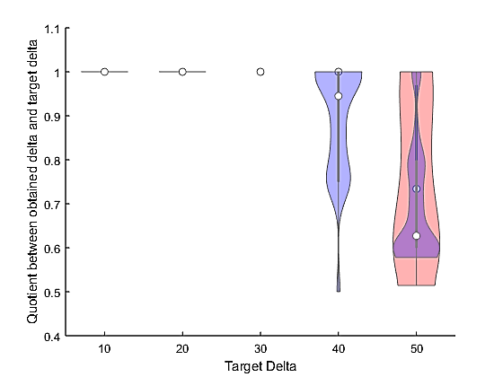
AllvsLPT

Slide 24
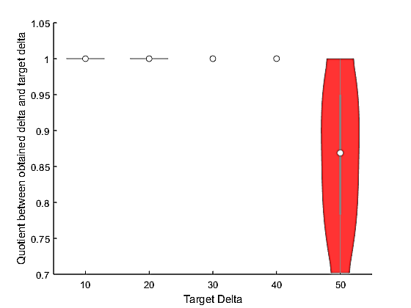
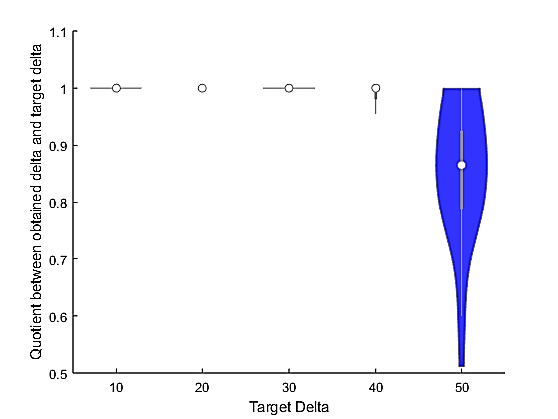
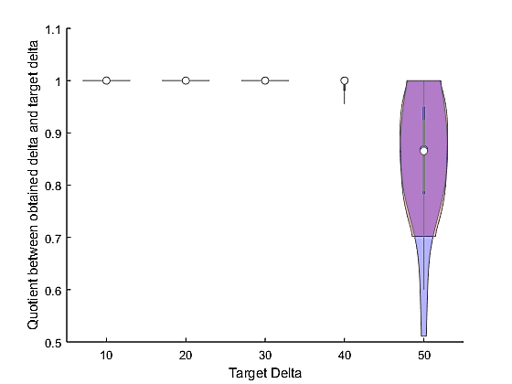
AllvsSPT

Slide 25
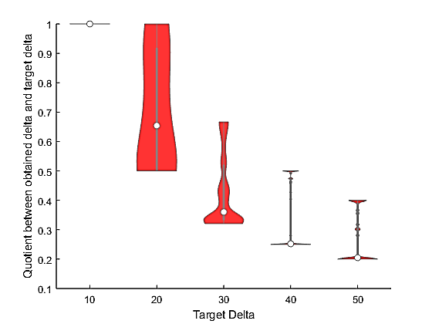
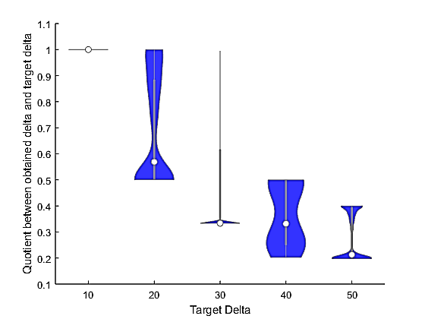
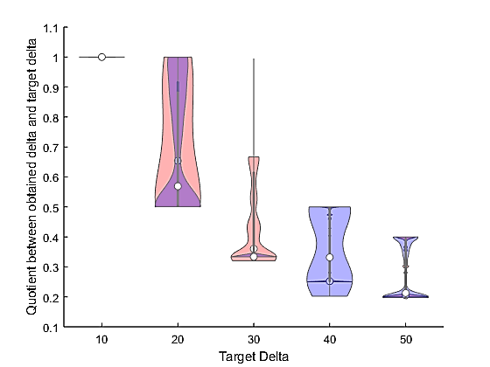
AllvsMPA

Slide 26
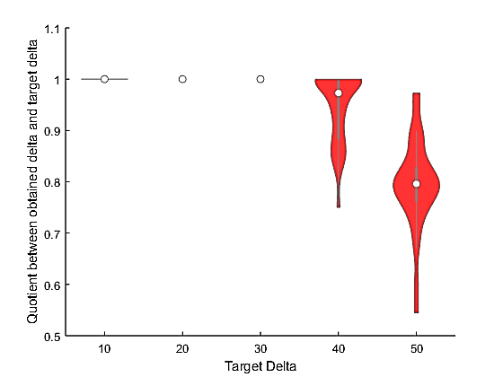
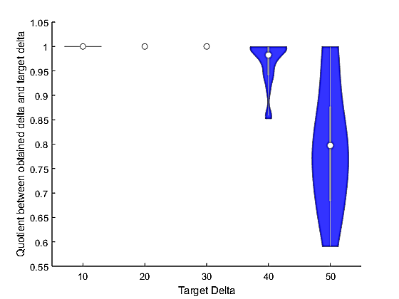
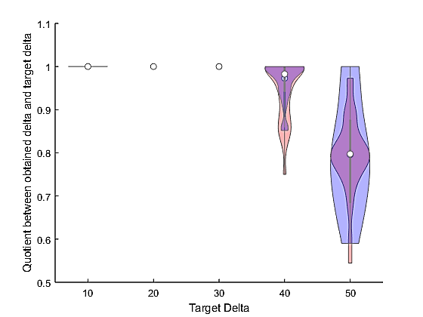
AllvsLPA

Slide 27
Delta Stage Parameters

Slide 28
Final Parameters

Slide 29
Final Parameters
Notes:
If making delta instances,
LPAvsAll change to: pop 10 SC 2.5 GC 2.5 UF 0.9
AllvsLPA change to: pop 10 SC 1.5 GC 1.5 UF 0.1

